Slide 1

CSG1105 / CSG5130
Applied Communications
Chapter 23
Security Software

Slide 2
Objectives
Explain how to capture network traffic with a sniffer and what value this activity provides
Discuss why port scanning is helpful in revealing vulnerable computers
Describe techniques used to crack passwords and ways to create a strong password

Slide 3
Objectives (cont’d.)
Explain how intrusion detection works and the difference between network-based intrusion detection and host-based intrusion detection
Discuss the vulnerabilities associated with remote access methods to a network and how to secure them
Explain the purpose of establishing and maintaining security policies and procedures

Slide 4
Packet Sniffing
Requires network adapter in promiscuous mode
  All received packets passed into TCP/IP stack
  No guarantee all network traffic on LAN captured
    Only captures packets existing on the network cable
  Switch-based limitation
    Switch forwards traffic to specific ports
    Resolve by mirroring port
Reasons to capture traffic
  Educational purposes, diagnostics, network baseline measurements, and security
Can lead to an invasion of privacy

Slide 5
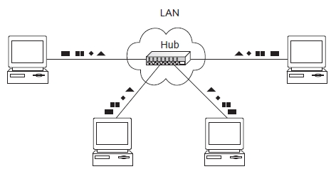
Figure 23-1(a) All LAN traffic is captured when the LAN is hub-based

Slide 6
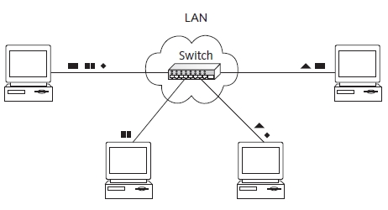
Figure 23-1(b) Limited traffic is captured when the LAN is switch-based

Slide 7
Port Scanning
Many ports to track
  65,536 UDP ports, 65,536 TCP ports
  Small subset typically in use
Netstat –a
  Displays list of ports in use
Netstat –a –n
  Translates certain names into associated IP addresses or port numbers
Netstat –a –b –n
  Displays processes associated with open ports

Slide 8
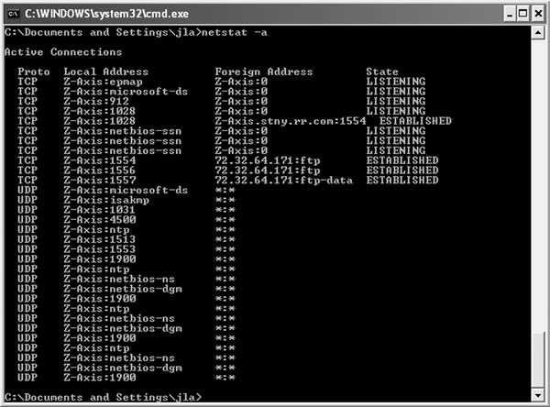
Figure 23-3 Displaying a list of active ports using netstat

Slide 9
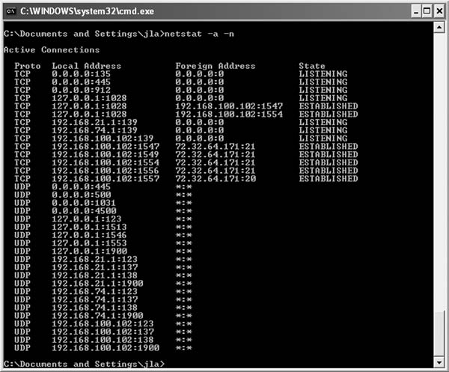
Figure 23-4 Netstat output of active ports with numerical
information added

Slide 10
Port Scanning (cont’d.)
Additional vulnerabilities
  Expand scanning process beyond open ports
    Unapplied patches, missing hotfixes and security updates, questionable services, and default administrator accounts
  GFI LANguard vulnerability scanner tool
    Scans host system and all computers on local network or Internet

Slide 11
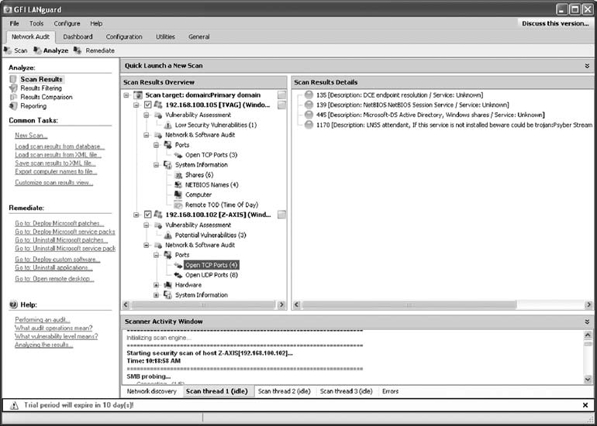
Port Scanning (cont’d.)
Figure 23-6 Results of a vulnerability scan on a small network

Slide 12
Password Cracking
Guessing a password
  Completely random approach
  Username and password written out clearly on sticky note
  Weak passwords
    Composed of information commonly known about an individual
Using Brute Force to Crack a Password
  Most time consuming
  Try all letter, number, symbol combinations
    Eventually correct password discovered

Slide 13
Password Cracking (cont’d.)
Dictionary attacks
  Use list of common passwords typically employed by many users
  Can download password dictionaries from the Internet
    Contain hundreds of thousands of words
    Specialized topics

Slide 14
Password Cracking (cont’d.)
Preventing a password attack
  Choose strong passwords
    At least eight letters, numbers, and symbols
  Do not write password down
    Use tricks to remember passwords
  Do not allow shoulder surfing
  Change password frequently; do not reuse passwords
IT department
  Force strong passwords; maintain password history
  Lock out user’s account after a certain number of failed attempts

Slide 15
Intrusion Detection
Examine traffic entering a network (computer)
  Determine if malicious
    Denial of service attack (DOS attack)
    Distributed Denial of Service Attack (DDOS attack)
Detection
  Look for characteristic signature of SYN flood attack
    Unique characteristic that can be recognized
  Upon entry into the network
  Upon entry into the computer

Slide 16
Intrusion Detection (cont’d.)
Host-based intrusion detection
  Network host responsible for examining its network traffic and recognizing signatures
    Denial of service attacks, buffer overflow attacks, and malicious code
  Uses software firewall and anti-virus application
  Must also verify system integrity (signatures not available)
    Examine critical system files for changes
  Expensive to implement
  Decentralized approach

Slide 17
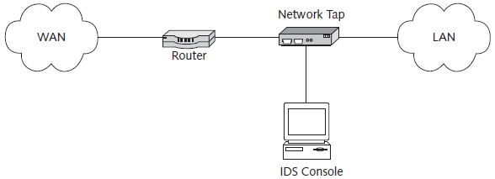
Intrusion Detection (cont’d.)
Network-based intrusion detection
  Centralized approach
  Less expensive than host-based intrusion detection
Figure 23-7 Using an intrusion-detection system to protect a network

Slide 18
Intrusion Detection (cont’d.)
Network-based intrusion detection (cont’d.)
  Attack detection
    Only as good as the rule (rules) written for its detection
  False positive alert
    Given when normal, non-malicious traffic matches one or more malicious traffic rules
  Passive IDS
    Examines traffic; notes suspicious behavior in log; may also notify network manager
  Active IDS
    Takes action on its own to handle problem (no user intervention)

Slide 19
Secure Remote Access
Many ways to access computer network remotely
  Eavesdropper may capture:
    Username, password, and entire sessions
  Secure access with encryption
  Secure dial-up connections with callbacks or access limitations

Slide 20
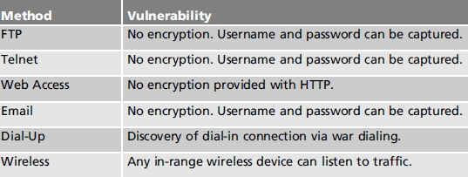
Secure Remote Access (cont’d.)
Table 23-1 Security vulnerabilities in remote access methods

Slide 21
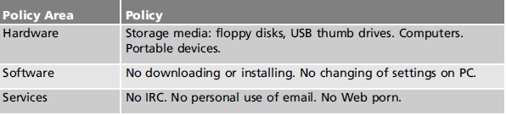
Security Policies and Procedures
Concerns proper use of hardware, software, and services provided by a network and the network computers
Table 23-2 Areas of concern in a network

Slide 22
Security Policies and Procedures (cont’d.)
Storage media
  USB thumb drives
    Popular way of transporting digital media
  USBs pose multiple security threats
    Smuggling confidential information out of a networked environment
    Introducing malicious code into networked computers
    Configuring with bootable operating systems
  Solution
    Configure BIOS to prevent removable disk booting
    Use a boot password

Slide 23
Security Policies and Procedures (cont’d.)
Portable devices
  Gain wireless access to business servers
  Solution
    Put all wireless devices on a separate VLAN
    No access to business servers or network traffic

Slide 24
Security Policies and Procedures (cont’d.)
Software
  Employer “free” Internet access
    Represents loss in productivity, security risk
  Issues
    Downloading Trojans and other malicious code
    User installing their own software creating unstable system

Slide 25
Security Policies and Procedures (cont’d.)
Services
  Company email not private
  Reasons to view
    Verify suspicions
    Employee performing illegal or banned activities
    Employee stealing company secrets
    Employee harassing another employee

Slide 26
Security Policies and Procedures (cont’d.)
The Acceptable Use Policy (AUP)
  Sets rules for how computers and network may be used
  Lists prohibited activities
  Describes consequences of non-compliance with the stated rules
  Required component of an overall security program
    May help limit legal liability from users who break rules

Slide 27
Security Policies and Procedures (cont’d.)
The Acceptable Use Policy (cont’d.)
  Contain the following elements
    Statement outlining expected computer and network use
    Code of conduct describing prohibited behaviors deemed unacceptable
    Description of consequences for violating the code of conduct
  Best written and comprehensive AUP:
    Only as good as the level to which enforced

Slide 28
Security Policies and Procedures (cont’d.)
Security procedures
  Security policy
    Provides rules and expectations and consequences of not following rules
  Security procedure
    Describes steps needed to execute the policy
  Developed by a group of individuals
    Group represents all organizational areas
  Goals
    Achieve protection deemed necessary
    Stay compliant with local, state, federal guidelines and laws

Slide 29
Troubleshooting Techniques
Discovering illegal or malicious network activity
  Firewall identifies banned website access
  IDS identifies known attack signature pattern
Discovering packet sniffing
  Use special applications
    Search for promiscuous mode computer adapter
    Use known traffic patterns, certain MAC addresses
    Look for reverse DNS evidence

Slide 30
Summary
Packet sniffing useful in troubleshooting
Port scanning identifies open ports
  Expand scanning process beyond open ports
Common password cracking approaches
  Guessing, brute force, and dictionary attacks
Intrusions detection based on identifying signatures
  Host-based and network-based
Remote access methods secured using encryption
Security policies ensure proper network hardware, software, and service use

